Slide 1
Deep Dive into ASP.NET Core Razor Pages 2.0
“Razor Pages is an awesome evolution of MVC”
@neekgreen | Nicholas Myers

Slide 2
Nicholas Myers is a software artisan; he mixes code and creativity to produce software that simplifies complex business problems. Nicholas has over thirteen years experience building quality software in a variety of industries, including electronic publishing, travel management, and both residential and commercial real estate. He is a graduate of the University of South Alabama - *Go Jags*! He is passionate about .NET Core, open source software, and helping developers build better software. As a wannabe-nutritionist, Nicholas spends his downtime cooking, baking, and working out - usually in that order.
@neekgreen | Nicholas Myers

Slide 3
What are Razor Pages?

Slide 4
Razor Pages is a new feature of ASP.NET Core 2.0 that makes page-focused web applications easy to manage and fast to develop.
#1

Slide 5
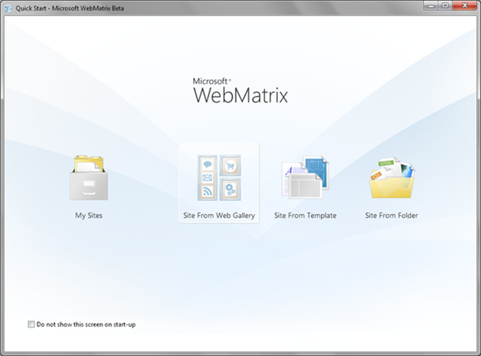
The name, Razor Pages, is a callback to WebMatrix and ASP.NET Web Pages, which was based on MVC3 that allowed server-side code within HTML pages.
#2

Slide 6
Razor Pages are optimized for anything browser related, especially GET/POST/REDIRECT workflows.
#3

Slide 7
Razor Pages are NOT a replacement for MVC; Razor Pages are actually built on top of MVC.
#4

Slide 8
Why Razor Pages?

Slide 9
What is wrong with ASP.NET MVC?

Slide 11
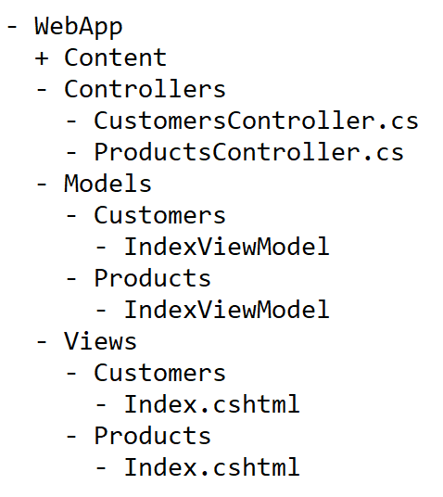

Slide 12
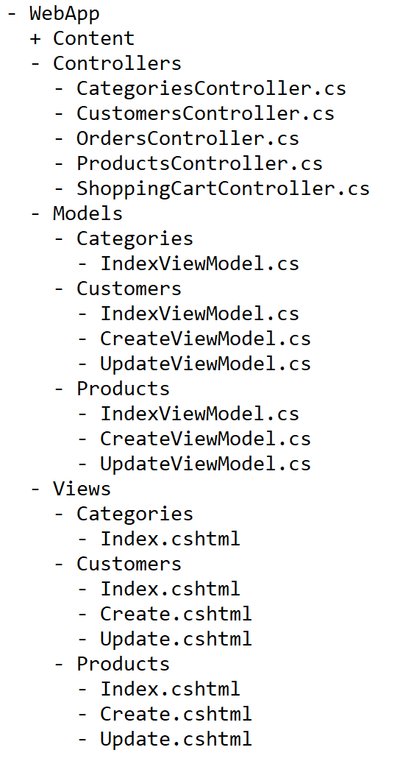

Slide 13
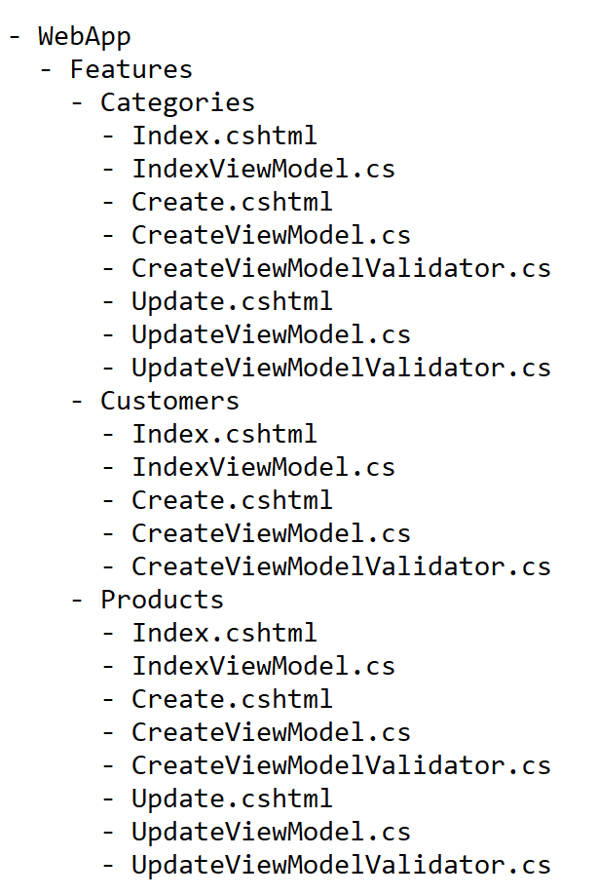

Slide 14
http://weddingphotography.com.ph/6897/guide-table-place-setting-dining-etiquette-manners-to-impress/

Slide 15
http://weddingphotography.com.ph/6897/guide-table-place-setting-dining-etiquette-manners-to-impress/

Slide 16
The Basics of Razor Pages.

Slide 19
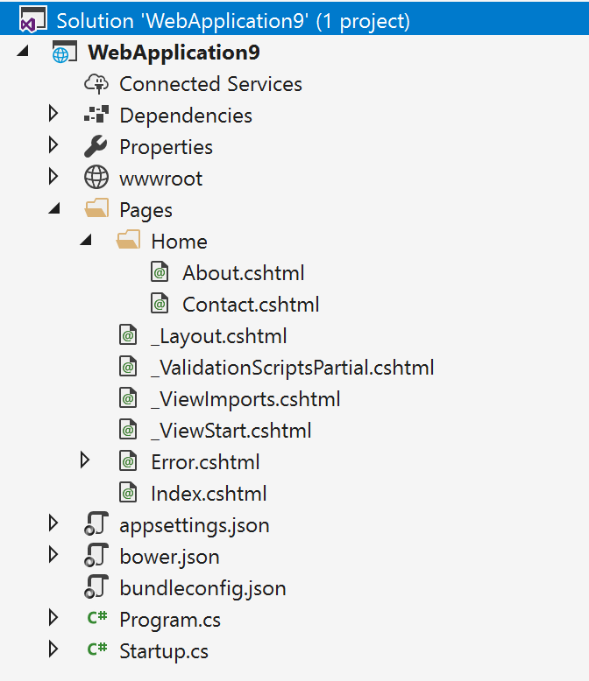
Where are the folders for controllers, views, and models?

Slide 20
http://localhost:5000/

Slide 21
http://localhost:5000/home/contact

Slide 22
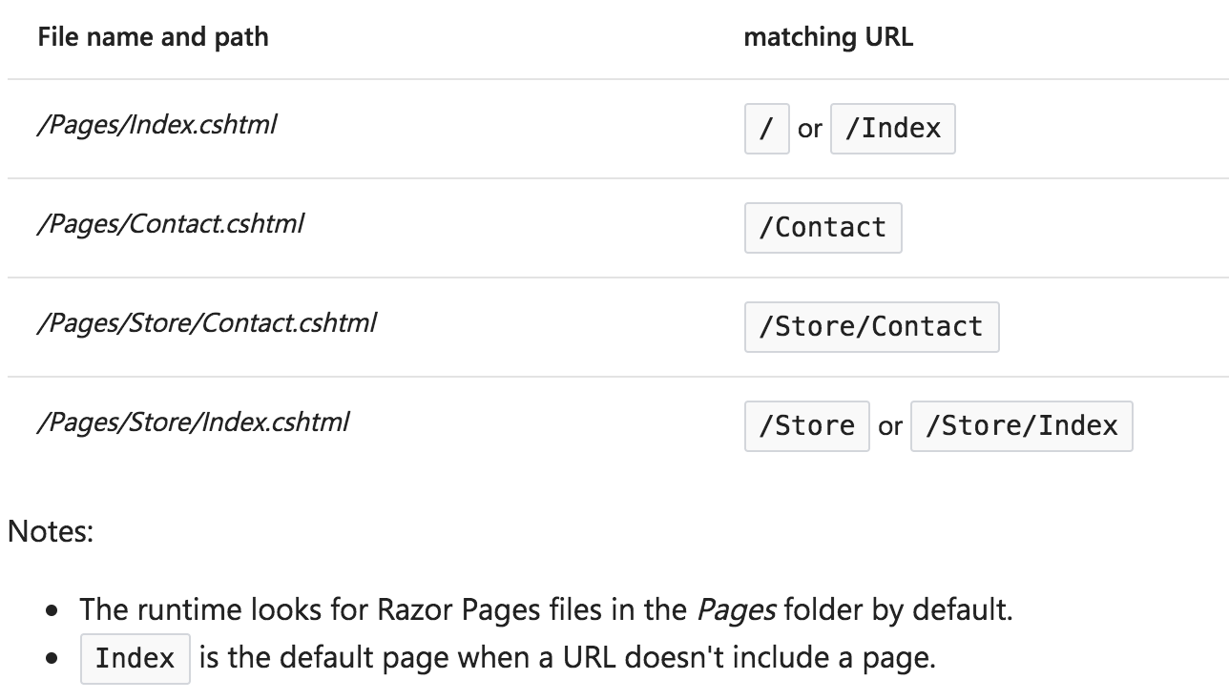

Slide 23
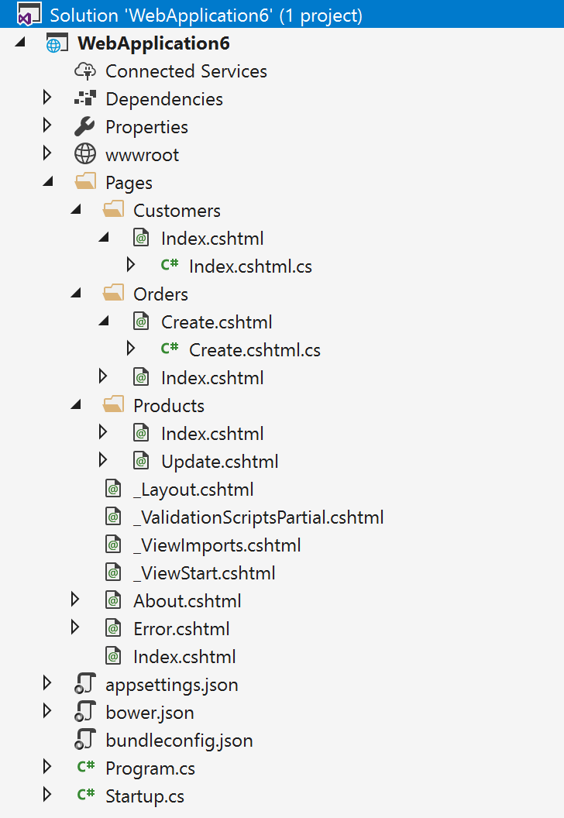
Feature Folders are apart of Razor Pages!

Slide 25
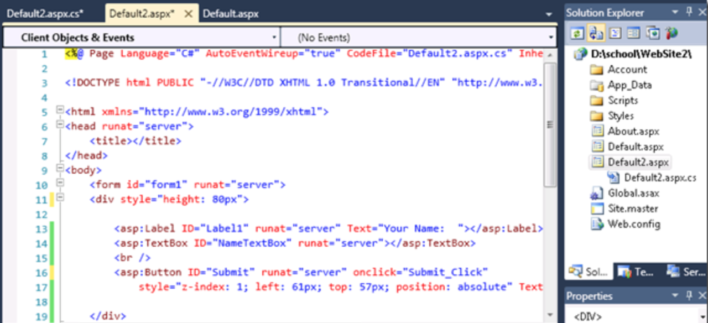

Slide 29
Can I Use ModelBinding in Razor Pages?

Slide 34
Can I Use Action Filters in Razor Pages?

Slide 37
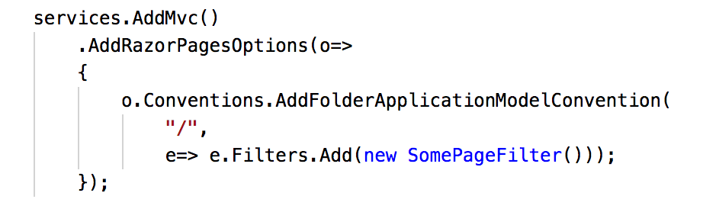
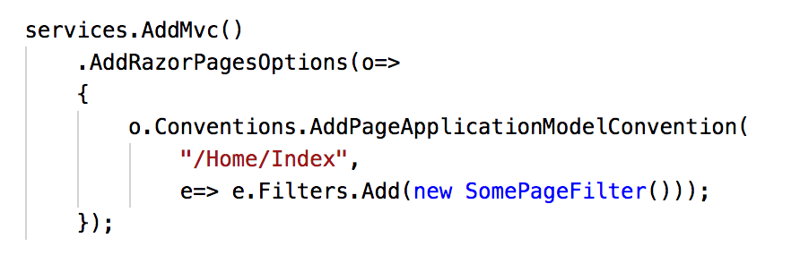

Slide 38
Can I Use Route Constraints in Razor Pages?

Slide 39
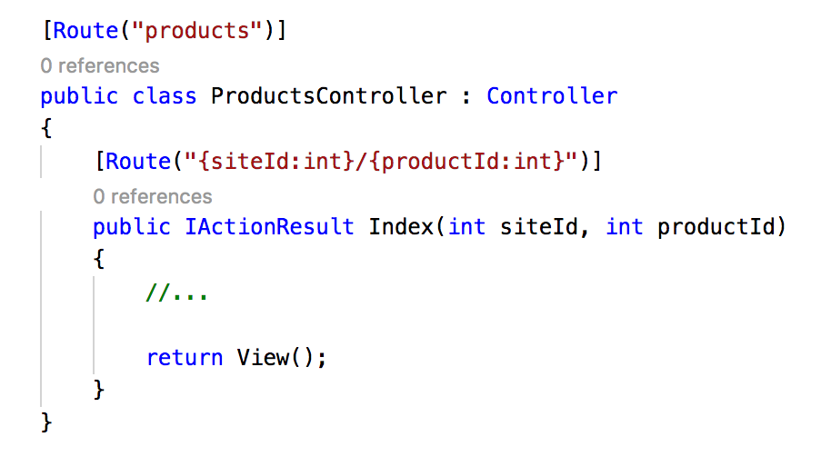
http://localhost:5000/products/101/10098

Slide 43
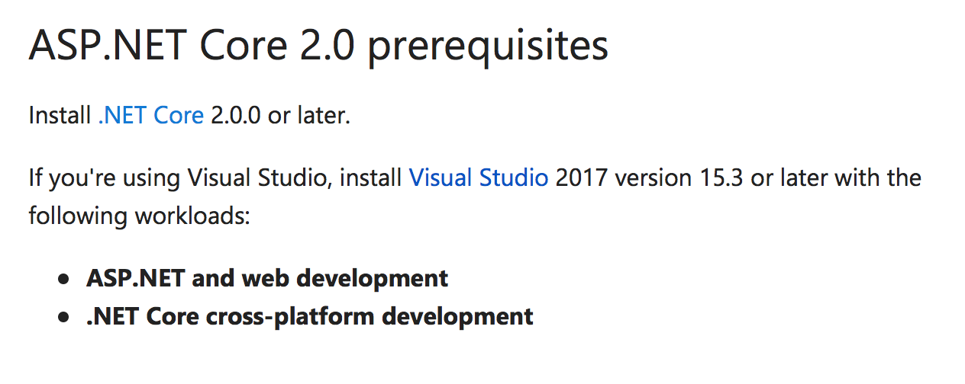

Slide 44
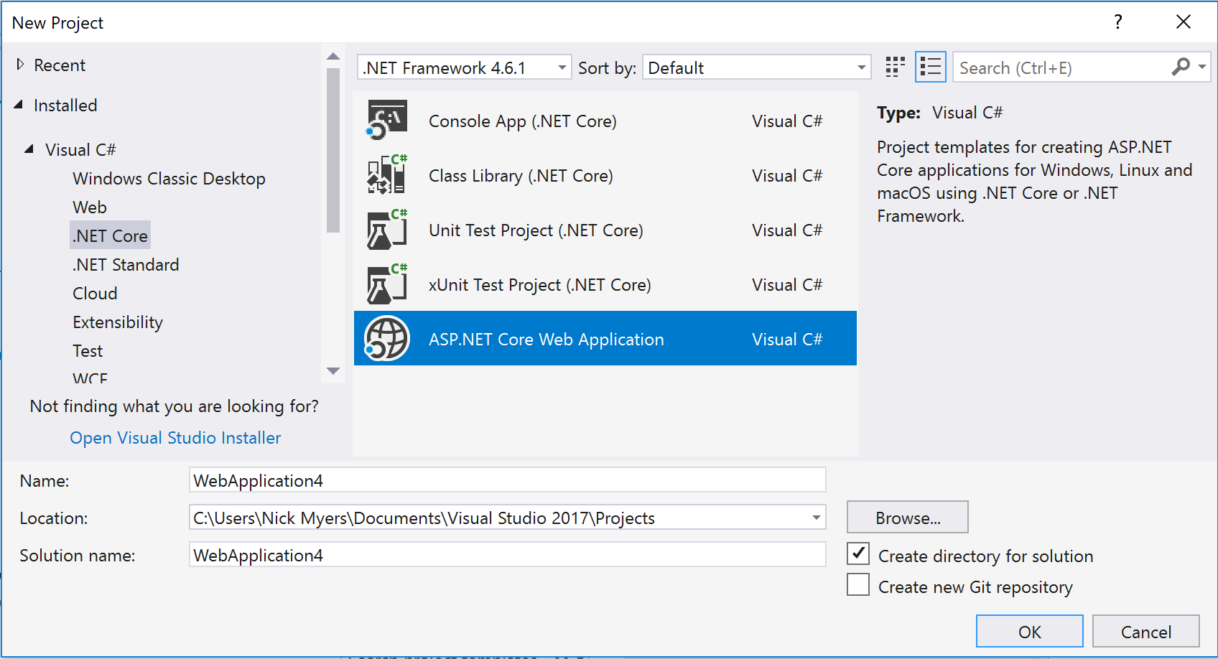

Slide 45
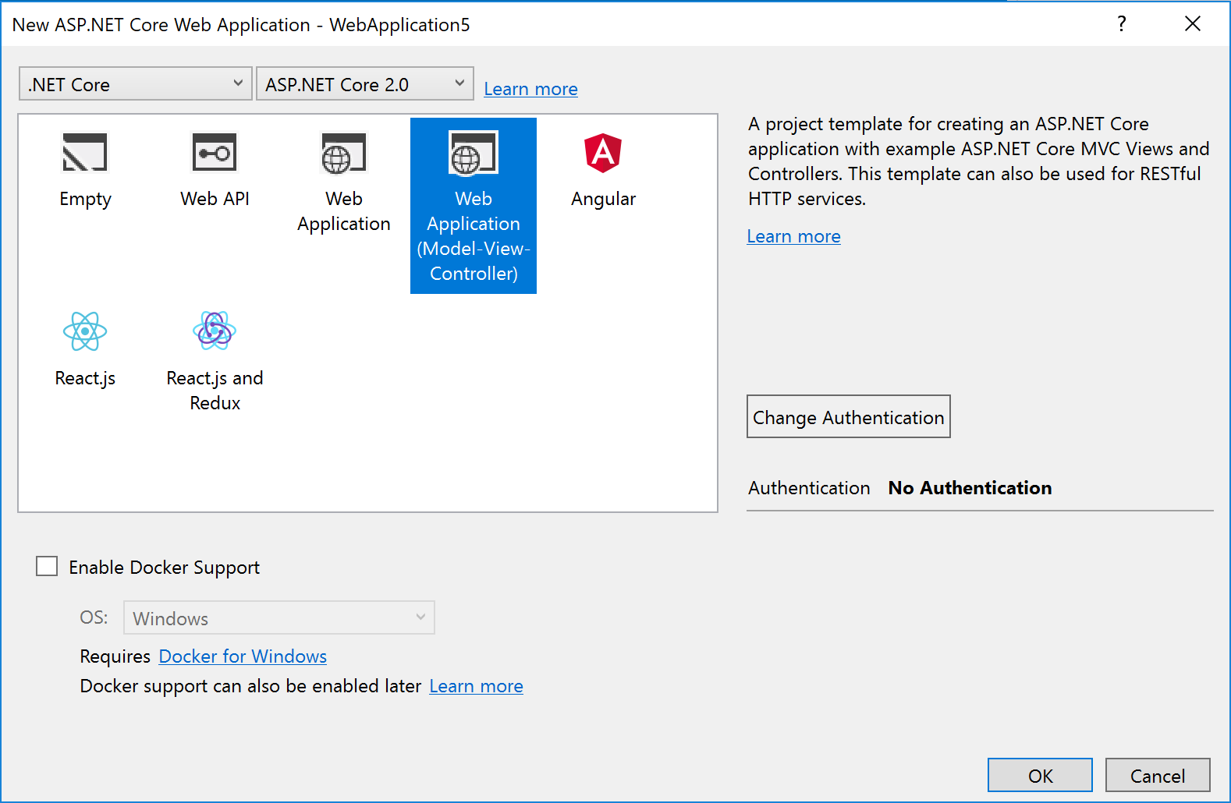

Slide 46
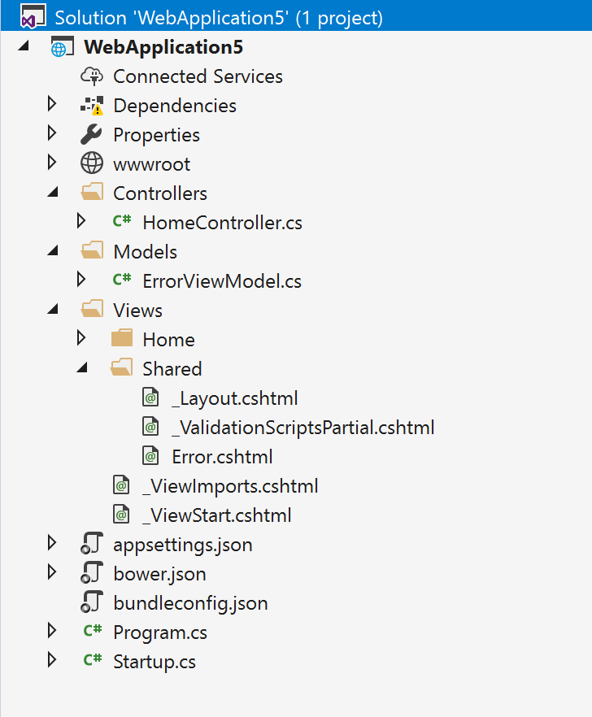

Slide 47
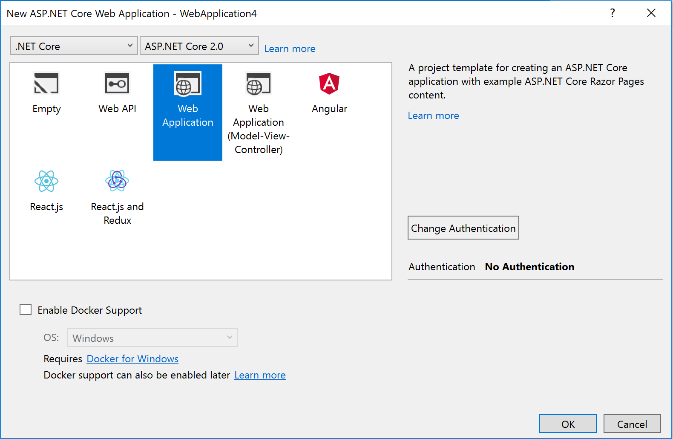

Slide 48
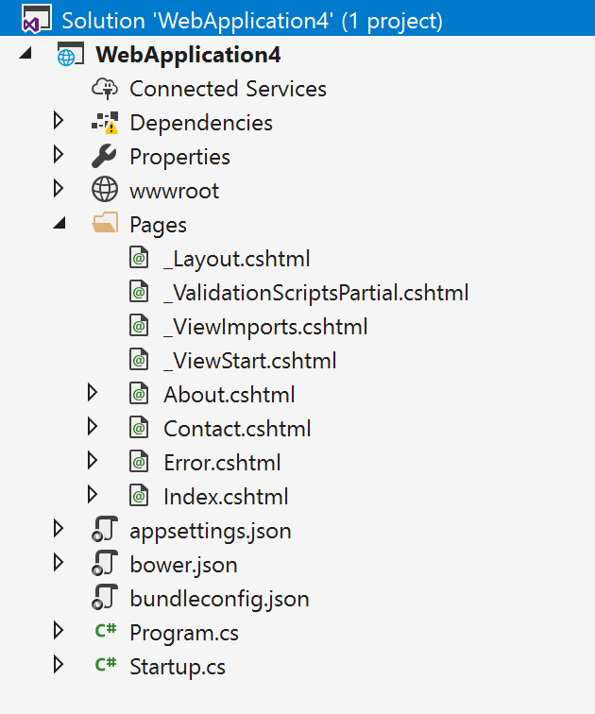

Slide 49
Demo

